Slide 1

Guidelines
Kindly use the given template for submitting your project (Make a copy of the template)
One team is only required to submit one project/ppt.
The ideal size of the presentation should not be more than 10 slides.
You are welcome to add as many POCs and design concepts to support your project.
The project should be feasible and the team members should be capable enough, to come up with the prototype of the same idea, if required.
Solutions must include at least one Google technology.

Slide 2
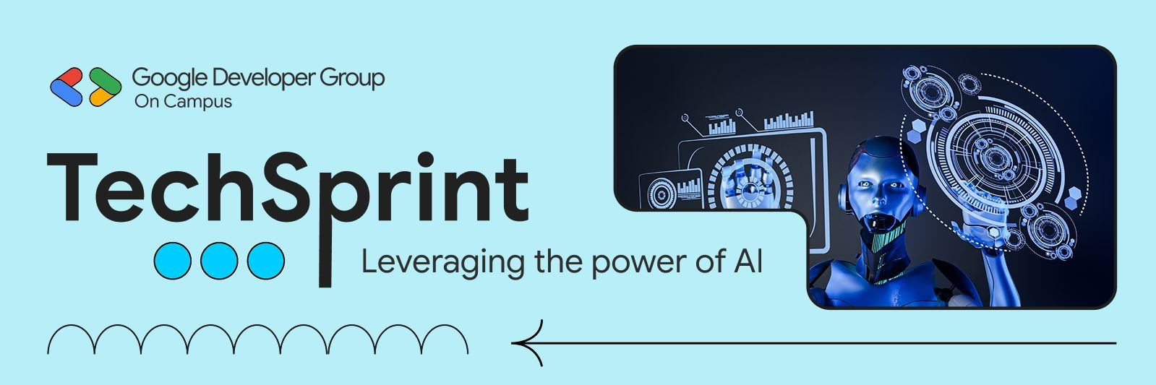
TEAM DETAILS:
Team Name: Exudus
Team Leader Name: Aadithia Venkat Suresh Kumar
Problem Statement:
•AI system to screen resumes and rank candidates by job skill fit

Slide 3
Brief about your solution and problem statement addressing:
Recruiters often receive a large number of resumes for a single job role. For them, manually reviewing each resume takes a lot of time and effort, and sometimes due to manual errors skilled candidates may be missed.
Our solution is an AI-Powered resume screening system that helps recruiters shortlist candidates more efficiently. The system analyzes resumes of the candidates, extracts relevant skills, and compares them with job requirements provided by the recruiter.
Based on this comparison, candidates are ranked according to their job-skill fit.
This allows recruiters to quickly Identity the most suitable candidates while keeping the final decision in human needs.
The solution reduces screening time, improves accuracy, and makes the hiring process faster and more reliable.

Slide 4
Opportunities
How different is it from any of the other existing ideas?
Most existing resume screening tools rely only on basic keyword matching.
Our solution uses AI to understand skills in context, not just exact words.
It provides a clear ranking based on job-skills fit instead of simple filtering.
The system is easy to use and designed to assist recruiters, not replace them.
How will it be able to solve the problem?
Reduces the time required to manually screen large numbers of resume.
Helps recruiters quickly Identify the most suitable candidates.
Improves consistency and accuracy in shortlisting.
Makes the hiring process faster, more reliable, and more efficient.

Slide 5
List of features offered by the solution
AI-based Resume Screening Automatically analyzes resumes and compares them with the job description to identify relevant skills.
Skill Extraction from Job Description Extracts key required skills directly from the job description provided by the recruiter.
Skill Extraction from Resumes Reads and processes uploaded resumes to identify candidate skills and technologies.
Candidate Skill Matching Compares job-required skills with candidate skills to find matching and missing skills.
Match Score Generation Generates a clear match percentage score for each candidate based on skill relevance.
Candidate Ranking Dashboard Ranks candidates in descending order of match score for quick decision-making.
Multiple Resume Upload Support Allows recruiters to upload and analyze multiple resumes at once.
User-friendly Interface Simple and clean interface that makes resume screening easy and fast.
Human-in-the-loop Decision Support The system assists recruiters, while the final hiring decision remains with humans.

Slide 6
Google Technologies used in the solution:
Google Gemini API Used to analyze job descriptions and resumes, extract relevant skills, and help calculate how well a candidate matches the job requirements.
Google AI Studio Used to create and manage the Gemini API key and test prompts for resume and job description analysis.
Google Cloud Platform (GCP) Provides the cloud infrastructure required to run and scale the AI-powered backend services.

Slide 7
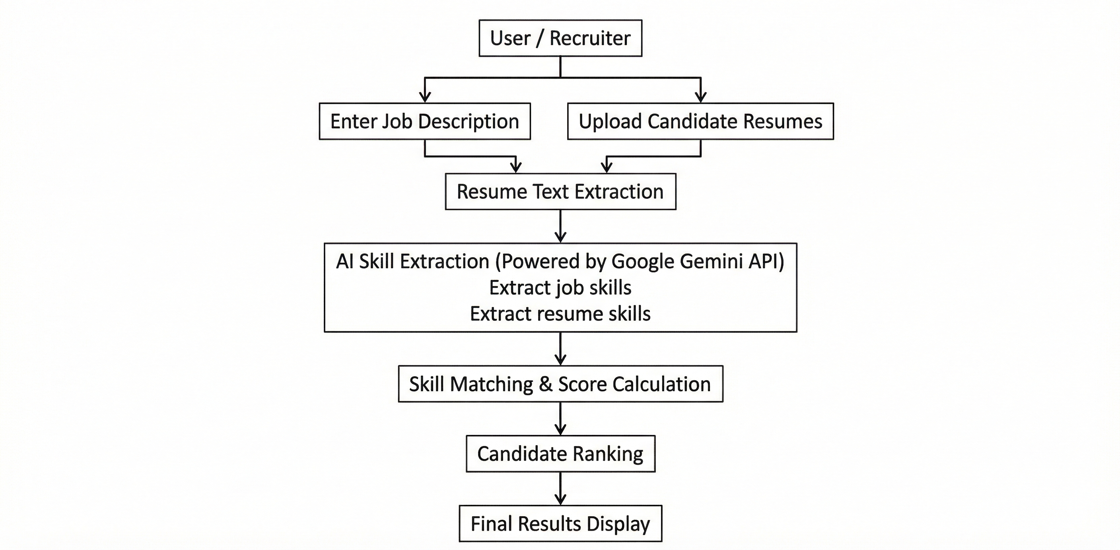
Process flow diagram

Slide 8
Architecture diagram of the proposed solution
USER / RECRUITER
Web browser
Interacts with the application
FRONTEND – React.js
Job Description
Form
Resume Upload Module
Candidate Ranking Dashboard
API Client(HTTP Requests)
Backend – Node.js + Express
REST API Layer
Resume Text Extraction Service
Skill Matching logic
Scoring & Ranking Engine
Google Gemini API
(Generative Language API)
Job Skill Extraction
Resume Skill Extraction
Semantic Skill Matching
HTTP/JSON
API Key
& Data
HTTP/JSON
Ranked Candidates
Extracted
Skills
Temporary Data Store / In- Memory Processing
Job Description Data
Extracted Resume text
Skills & Match Scores
Data
Storage

Slide 9
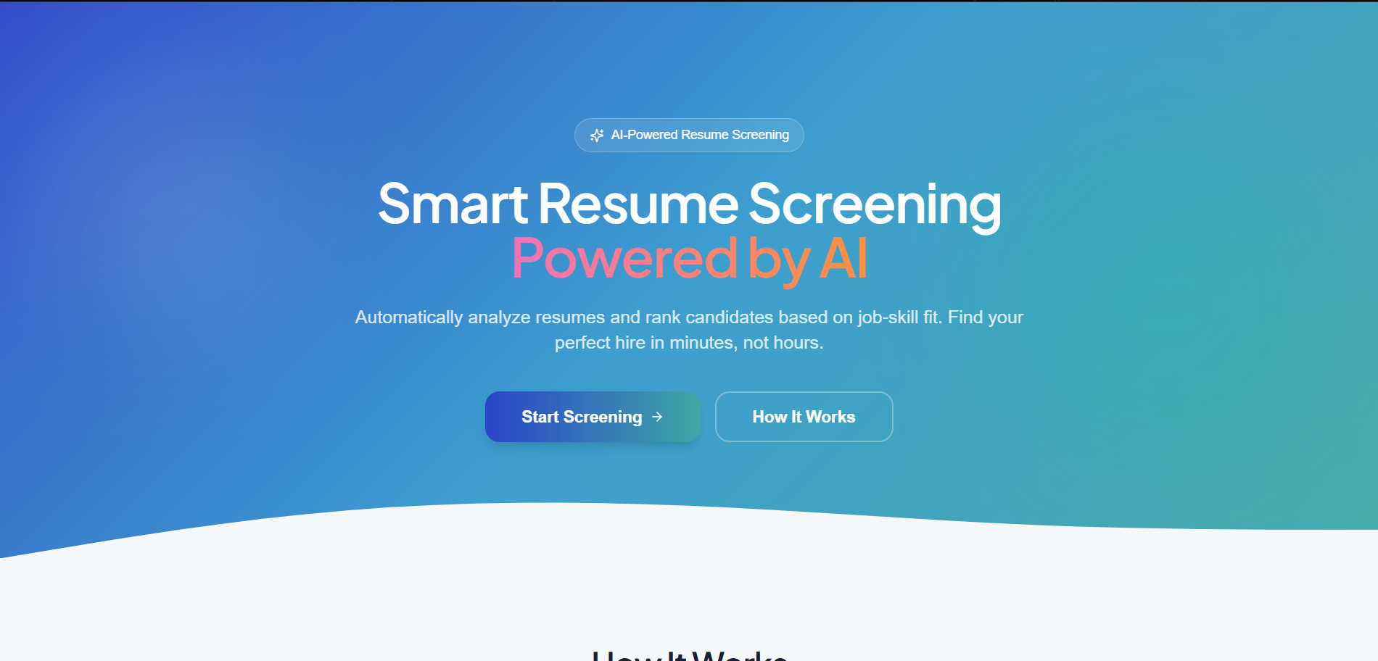
Snapshots of the MVP

Slide 10
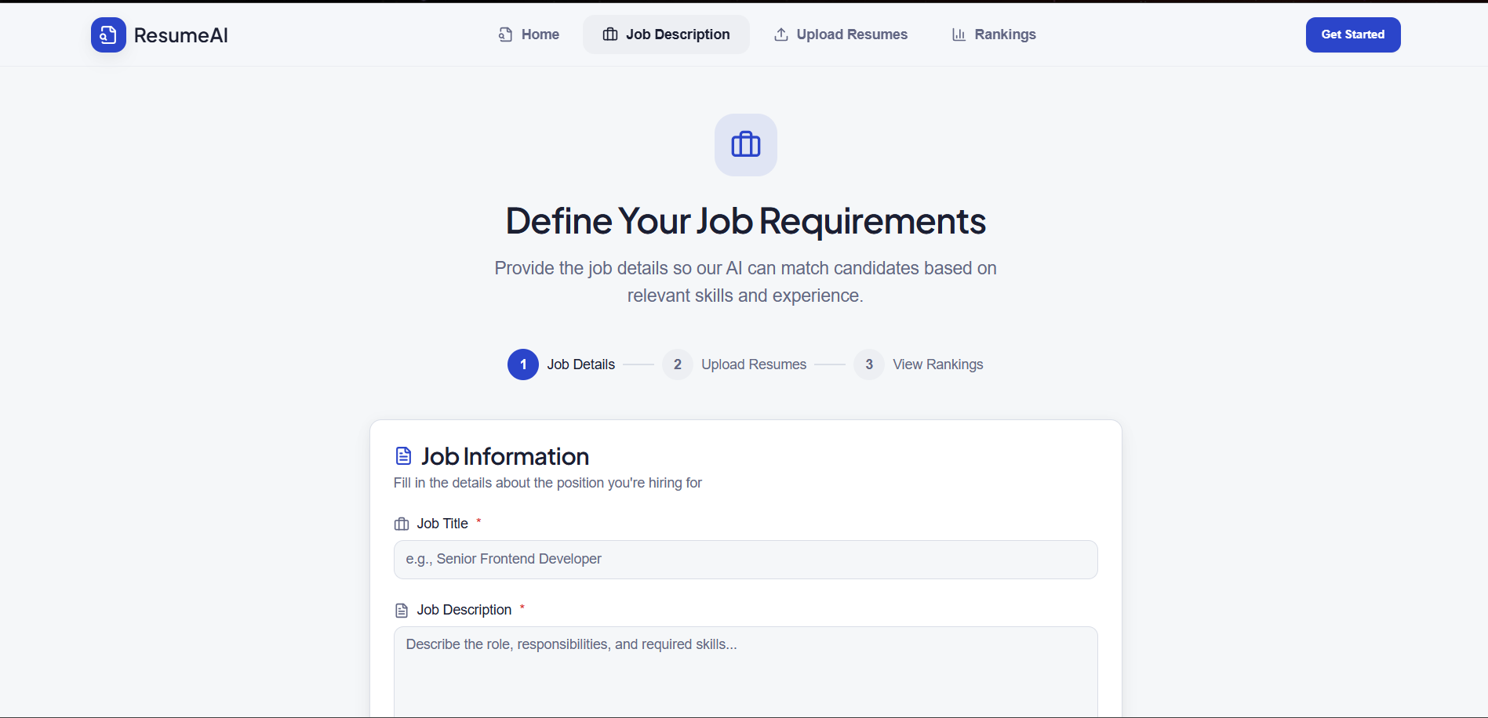

Slide 11
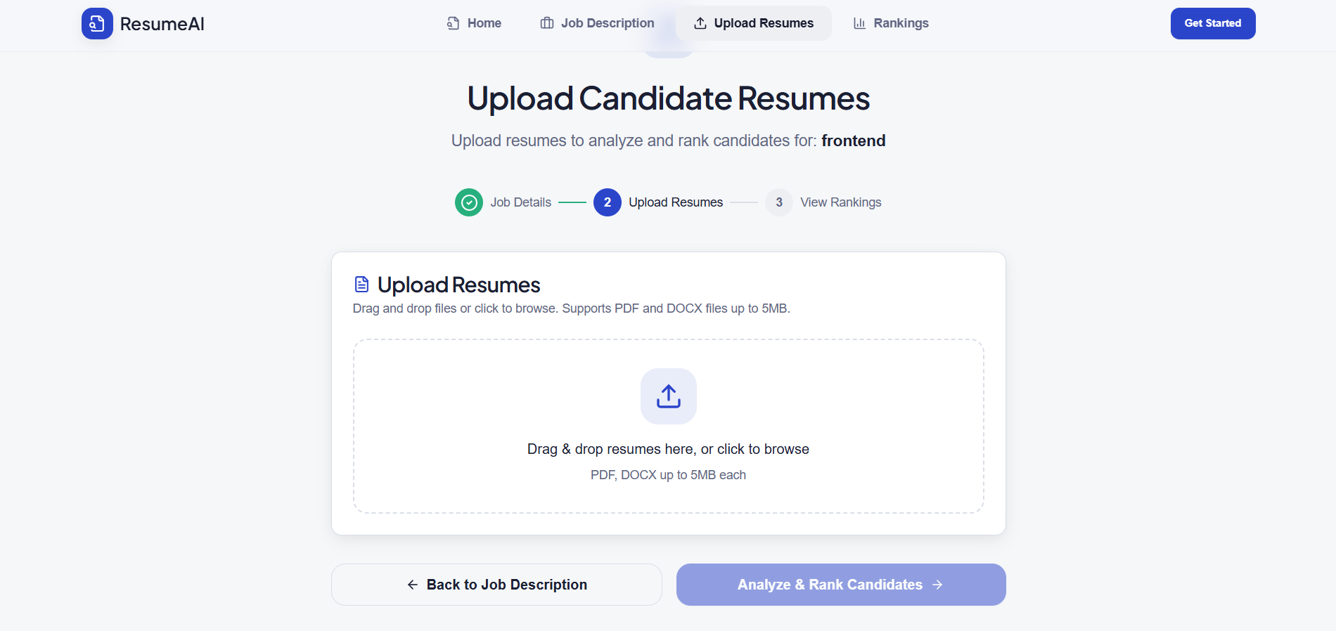

Slide 12
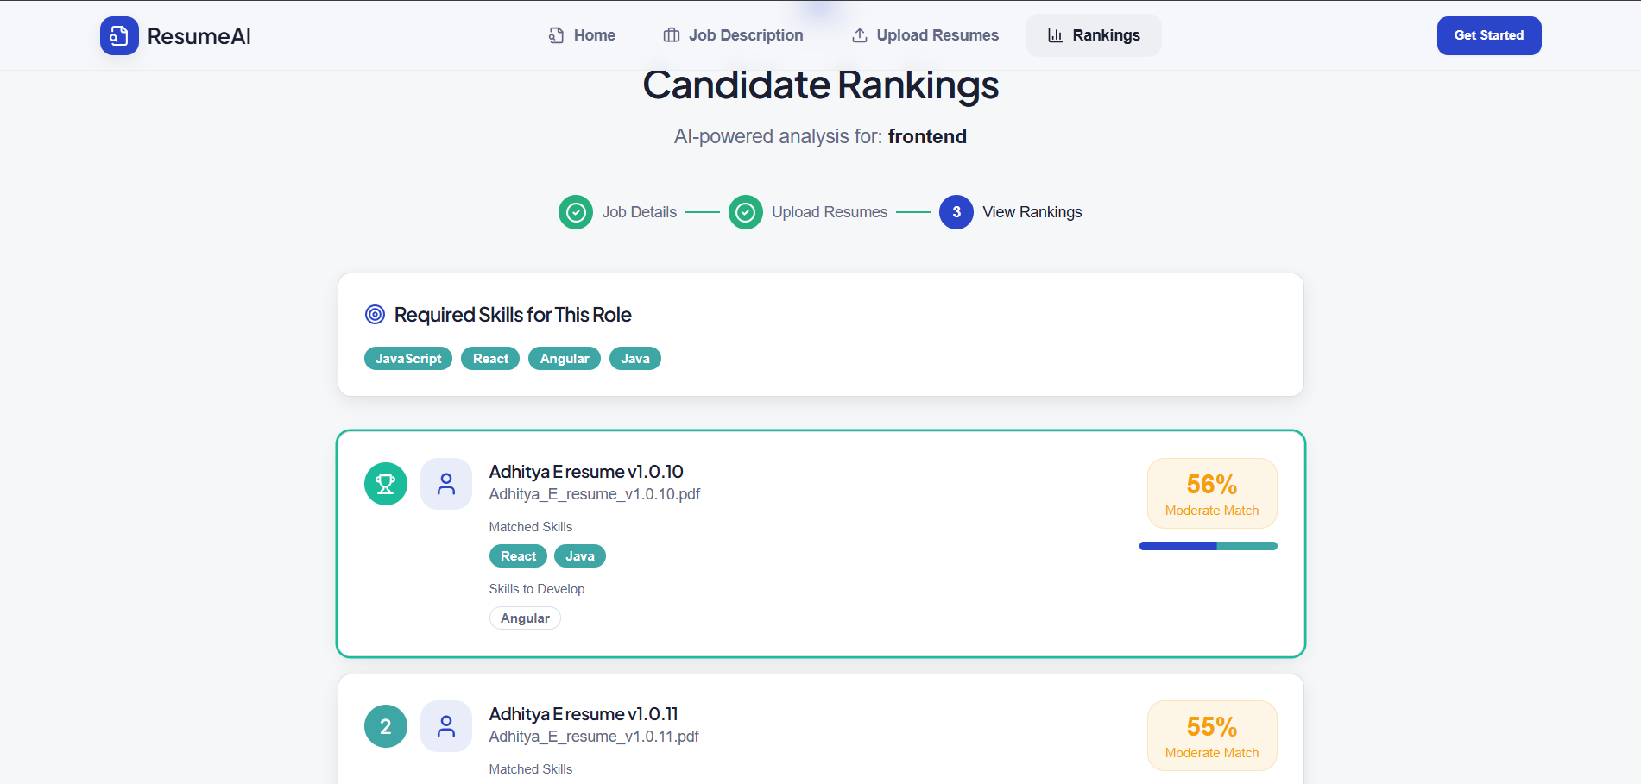

Slide 13
Additional Details/Future Development (if any)
1. Support for Scanned Resumes (OCR Integration)
Currently, the system works best with text-based PDFs and DOCX files
In the future, OCR (Optical Character Recognition) will be added
This allows the system to read scanned or image-based resumes
Ensures no resume is rejected due to format limitations
Benefit: Recruiters can upload any resume format without manual conversion.
2. Soft Skill Detection
AI will identify soft skills such as:
Communication
Leadership
Teamwork
Problem-solving
These are detected from:
Resume descriptions
Project explanations
Achievements
Benefit: Helps recruiters evaluate personality and work behavior, not just technical skills.

Slide 14
Provide links to your:
GitHub Public Repository
Demo Video Link (3 Minutes)
MVP Link

Slide 15
Thank you!

